Slide 1



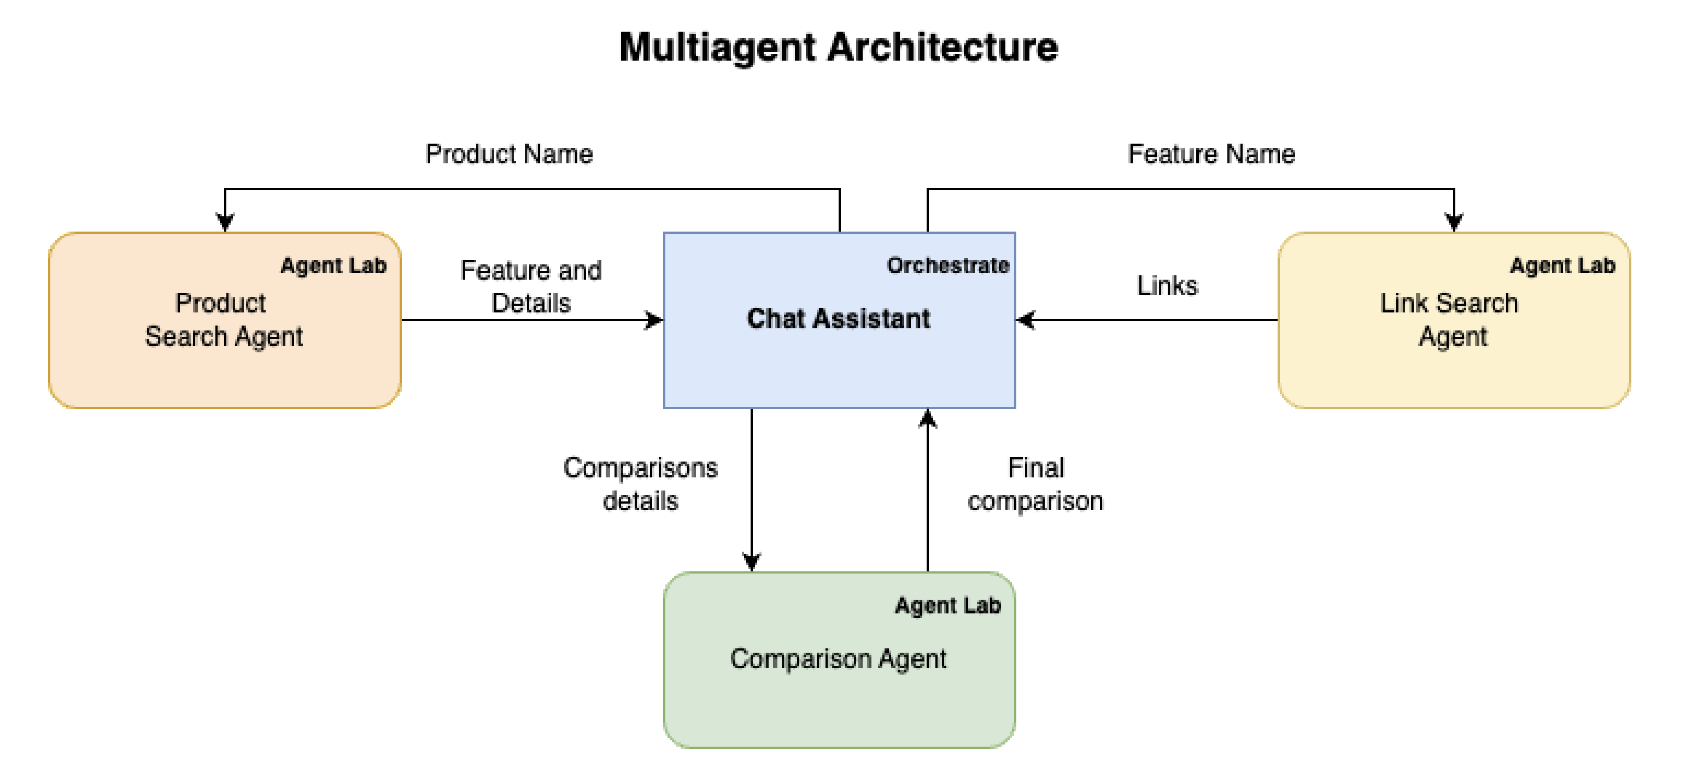

Accenture report says “enterprises are beginning to embrace AI agents, noting that 77% of executives agree AI agents will reinvent how their organization builds digital systems. Additionally, 48% of executives say AI agents would improve flexibility of their organization’s digital architecture”
Usecase: Business Automation
Read the Accenture Report
AI-Powered Competitive Intelligence: Automating Research to Supercharge Sales Productivity
Methodology – Agent Definition
Product Search Agent : This agent is designed to *search* for a specified product and retrieve its details and features in a structured format.
Link Search Agent : This agent is expert in finding URLs or links for similar products that share matching features, ensuring users can explore alternatives efficiently.
Comparison Agent : This agent is to carefully analyze the input data, extract key insights, and identify both differences and similarities and presented in a well-structured table format.
The sales department of ABC Corp, a sales-driven enterprise, when preparing proposals, they were spending a lot of time understanding the features of competing products and comparing them with their own products.
Goal
Architecture
The customer is a sales department, and when preparing proposals, they were spending a lot of time understanding the features of competing products and comparing them with their own products. Therefore, the goal of the demo to be created this time is to support the customer's competitive analysis.
Resources
Business value
https://github.com/haneen-bakbak/agentic-ai-workshop.git
Reduction in manual competitor research time.
Automated, real-time updates on market competition.
Improved sales pitch effectiveness
1
© 2025 IBM Corporation

